Slide 1



Bad CMO
Good CMO
Shoham Eckhaus
Chief Strategist and CMO at Penguin Strategies
December 2019

Slide 2

The title for this presentation was inspired by
Ben Horowitz who wrote the famous essay 20 years ago named:
Good Product Manager / Bad Product Manager
Link to the essay

Slide 3










5 top recommendations
to help you be a
Good CMO / Marketer / Founder / Dig. Mktg. Leader

Slide 4

CONSISTENCY

Slide 5

A good CMO
values
Consistency
just as much as
quality

Slide 6

A bad CMO
will publish
inconsistently,
aiming for all content to be “perfect!”

Slide 7

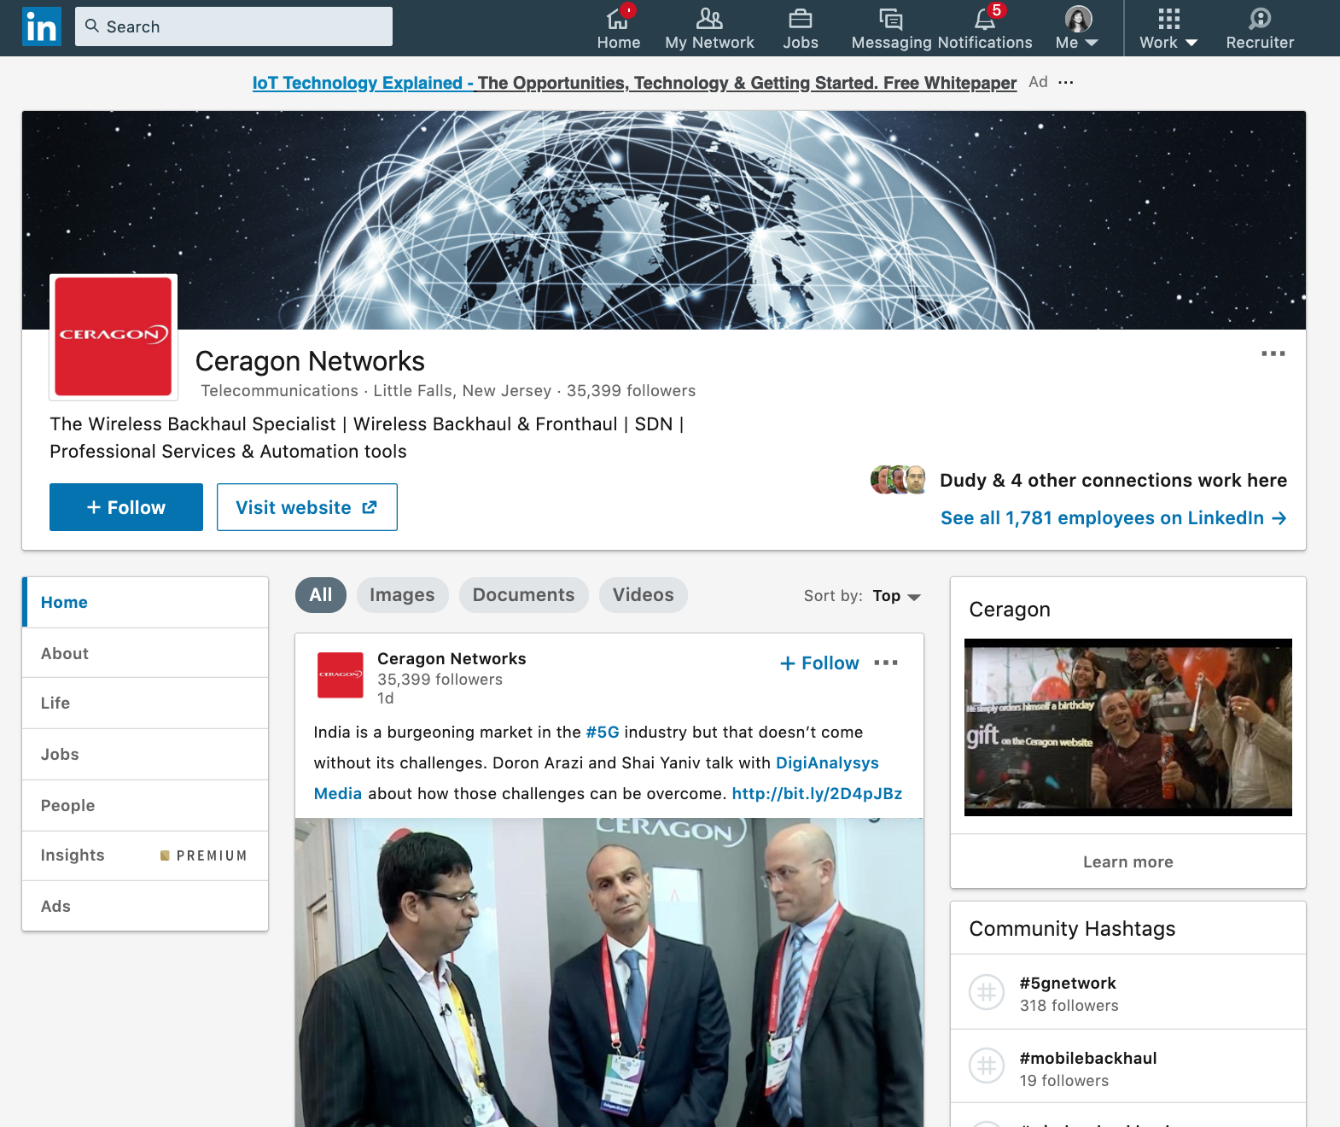
GREAT EXAMPLE #1: CERAGON

Slide 8

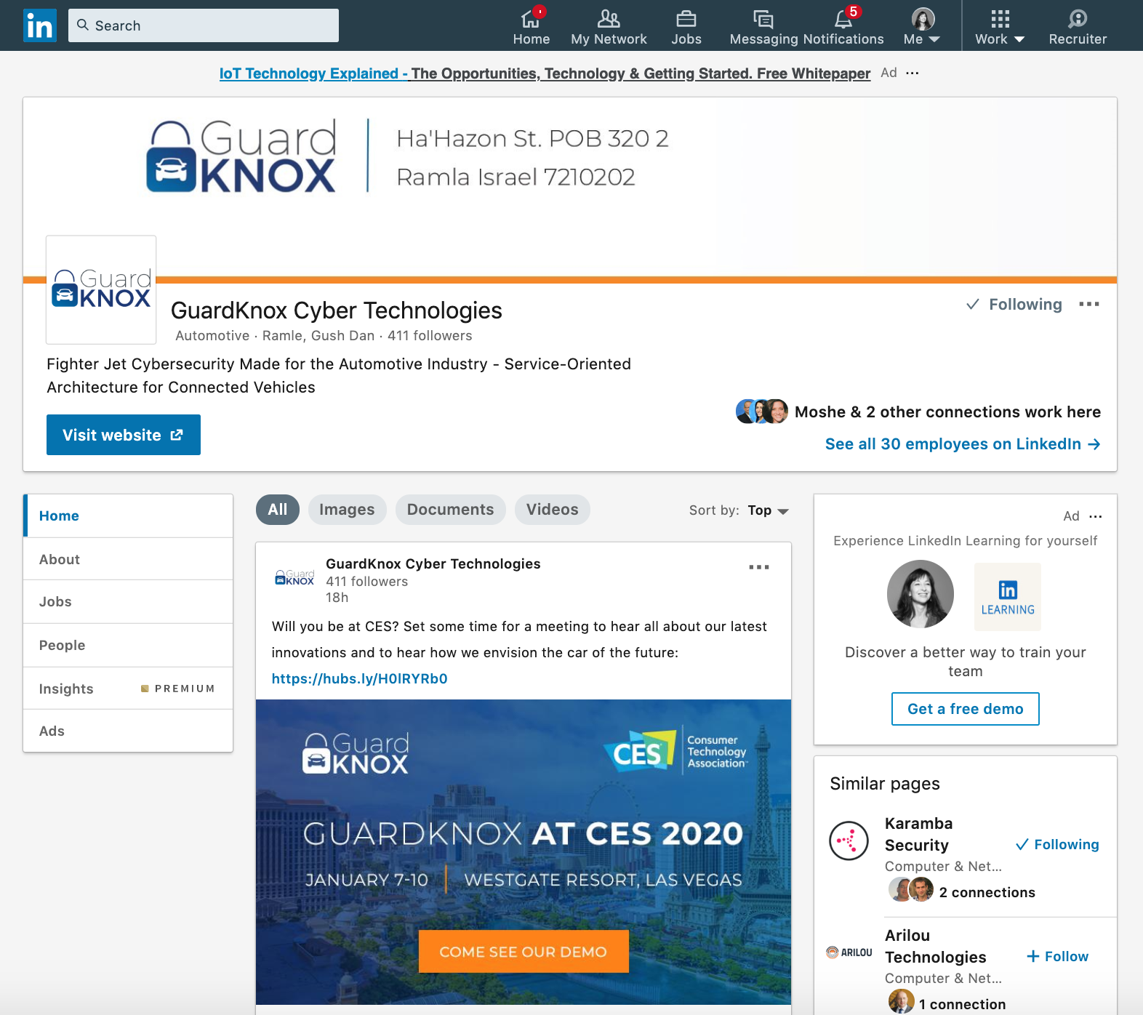
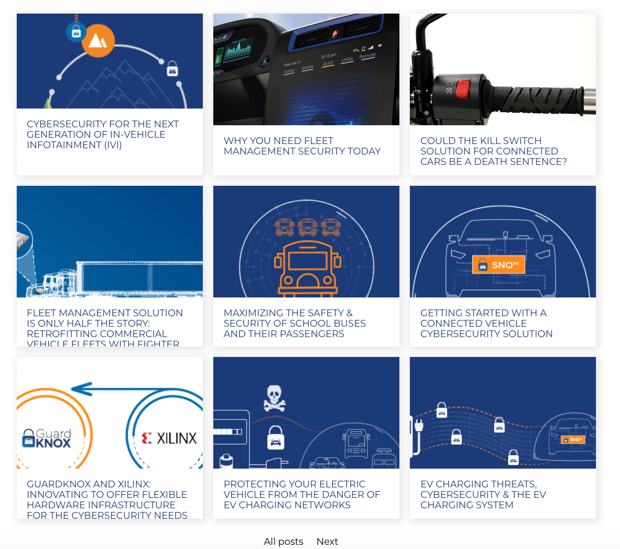
GREAT EXAMPLE #2: GuardKnox

Slide 9

LONG TERM EFFORTS

Slide 10

A good CMO
balances between short term mid term, and
long term wins

Slide 11
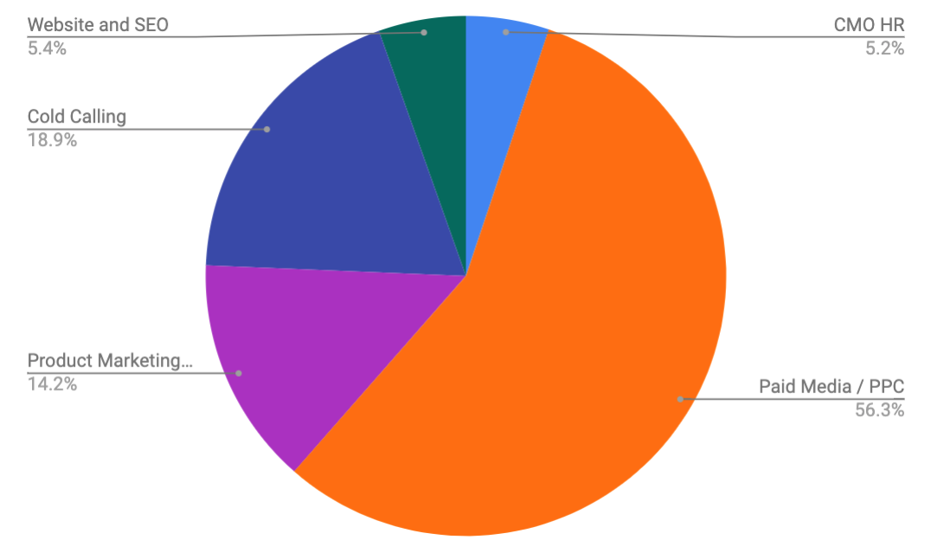
A bad CMO
is obsessed with the
short term wins...
“We need to see the results in days… can’t afford to wait for weeks/months”

Slide 12
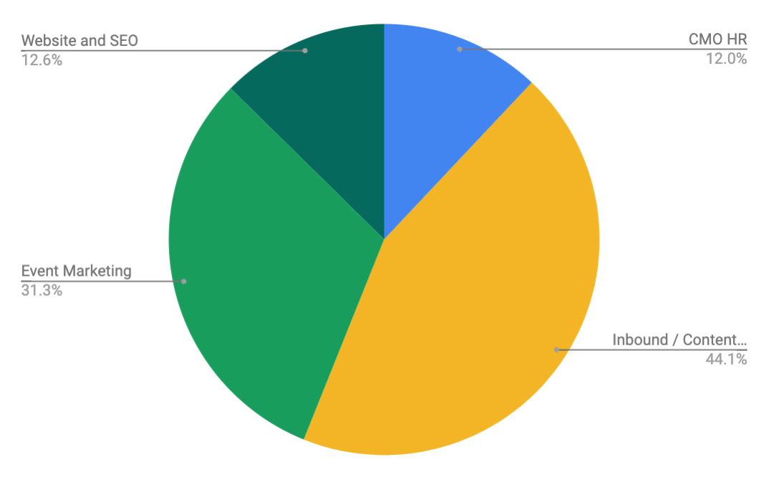
Or
totally neglects
short term wins...
“We will make a great product, educate them and they will come to us…”

Slide 13

Example of marketing assets that take time to build and pay off, but their impact is big:
Build a community

Slide 14



Example of marketing
assets that take time to
build and pay off, but their impact is big:
Publish a Book
Full story on the podcast episode I recorded with Avi Nowitz from Presenso on Authority Building

Slide 15
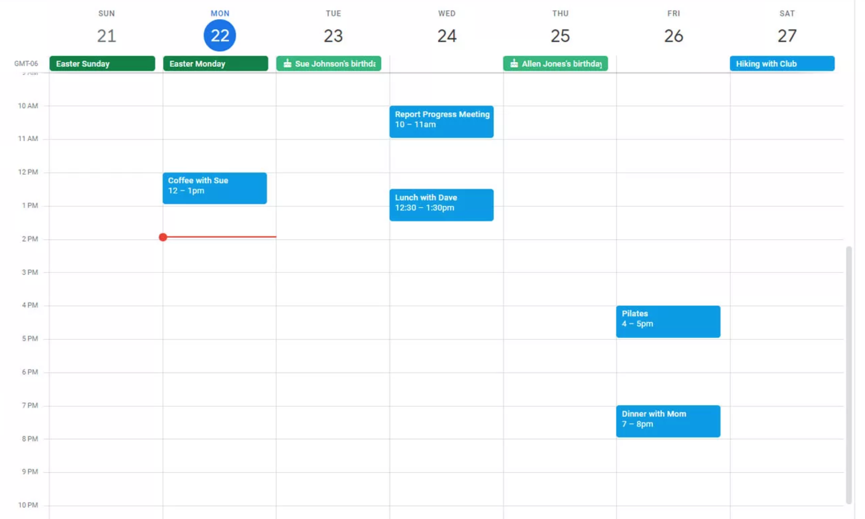
A good CMO
balances between short term mid term, and
long term wins
short
long
long
long
short
short
long
short

Slide 16

CUSTOMER JOURNEY

Slide 17
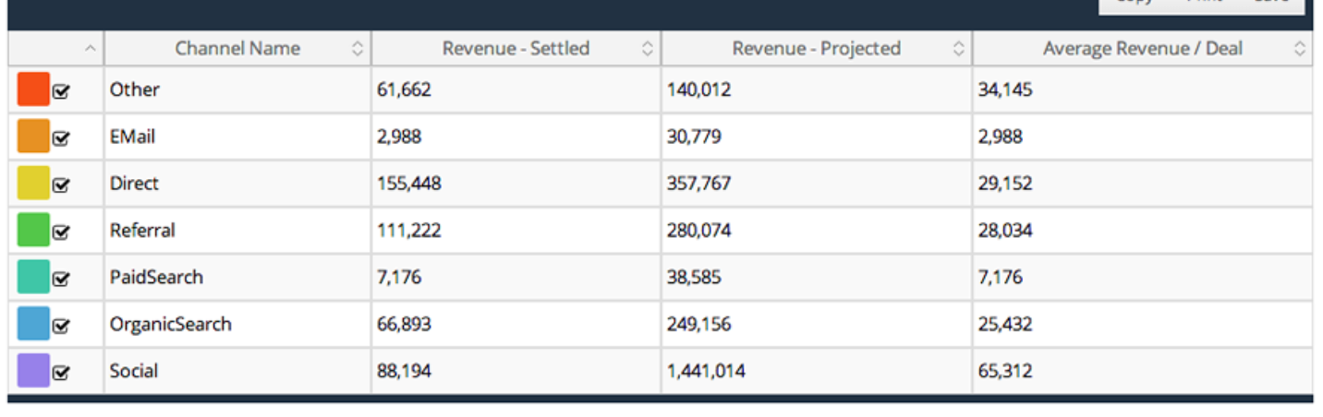
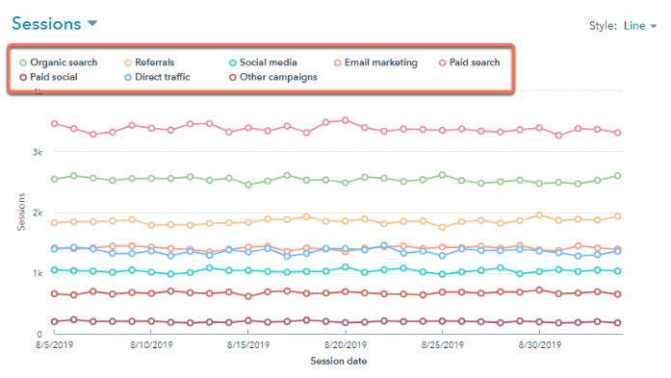
A bad CMO
compares performance
of marketing
“channel”
based on
“lead source”

Slide 18
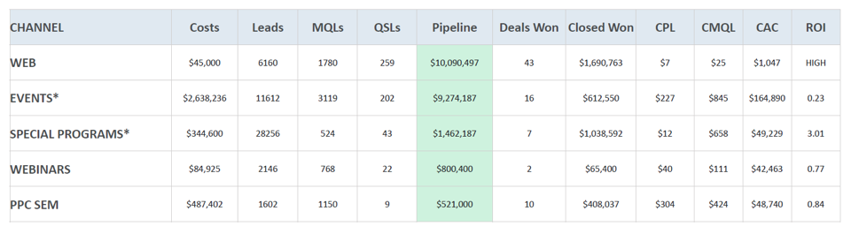
Channel Effectiveness
Quarterly report to company board
Slide from template provided by a leading VC to their portfolio companies

Slide 19
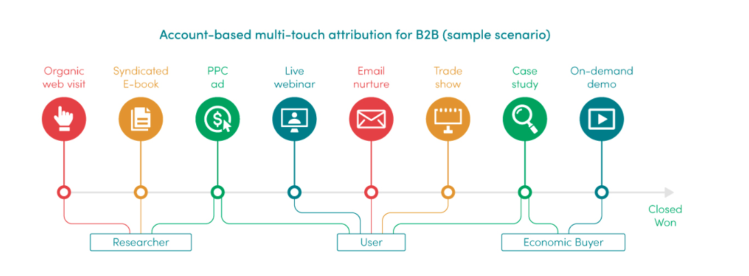
A good CMO
understands customer journeys based on multi-touch attribution
Source: https://www.attributionapp.com

Slide 20

A good CMO
understands customer journeys based on Qualitative Research
Interview a sample of your best clients
Interview lost-deals
Identify the funnel in great detail
For every step of the funnel identify:
  Dominant personas
  Mindset
  Triggers
  Pushbacks
  Influences

Slide 21

A good CMO
Is the maestro
of customer journey

Slide 22

PLAYBOOK

Slide 23
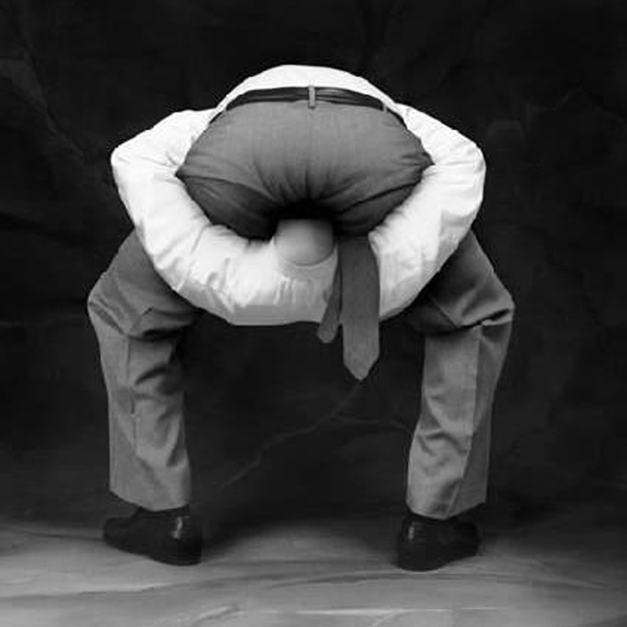
A bad CMO
doesn’t have a
“marketing playbook”

Slide 24
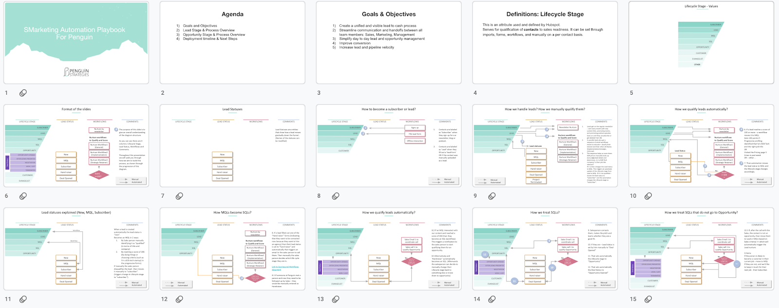
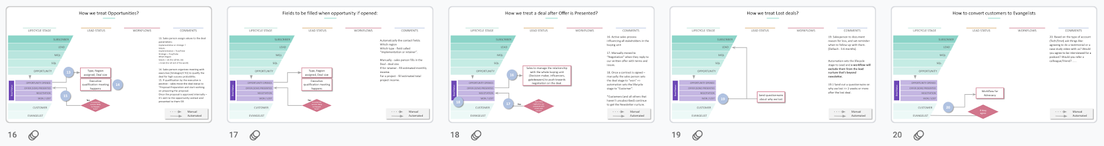
SAMPLE PLAYBOOK

Slide 25
WHY YOU NEED A PLAYBOOK?
Creates a unified and visible ‘lead to cash’ process
Streamline communication and handoffs between all team members: sales, marketing, management
Simplify day to day lead and opportunity management
Improve conversion and velocity

Slide 26
A good CMO
communicates the company’s
“marketing playbook”
clearly and coherently to all collaborators
Dancers in sync

Slide 27
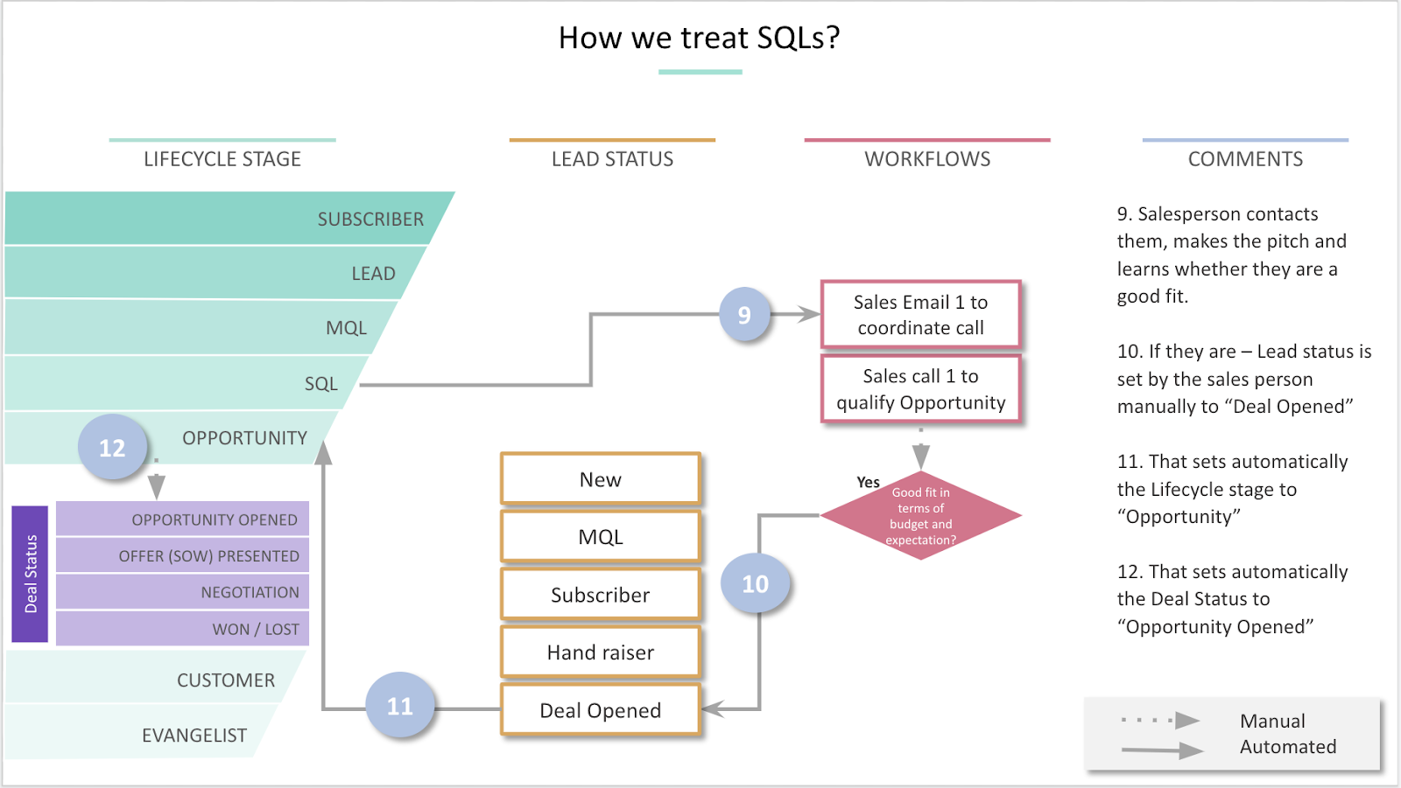
PLAYBOOK TEMPLATE
Use this template plus listen to podcast episode with Mark Fisher where we explain how to build your playbook.
Download

Slide 28

EXPERIMENTS

Slide 29

A bad CMO
will not share the thought process with management and will be blamed for taking the wrong route once
results lag behind expectations...

Slide 30
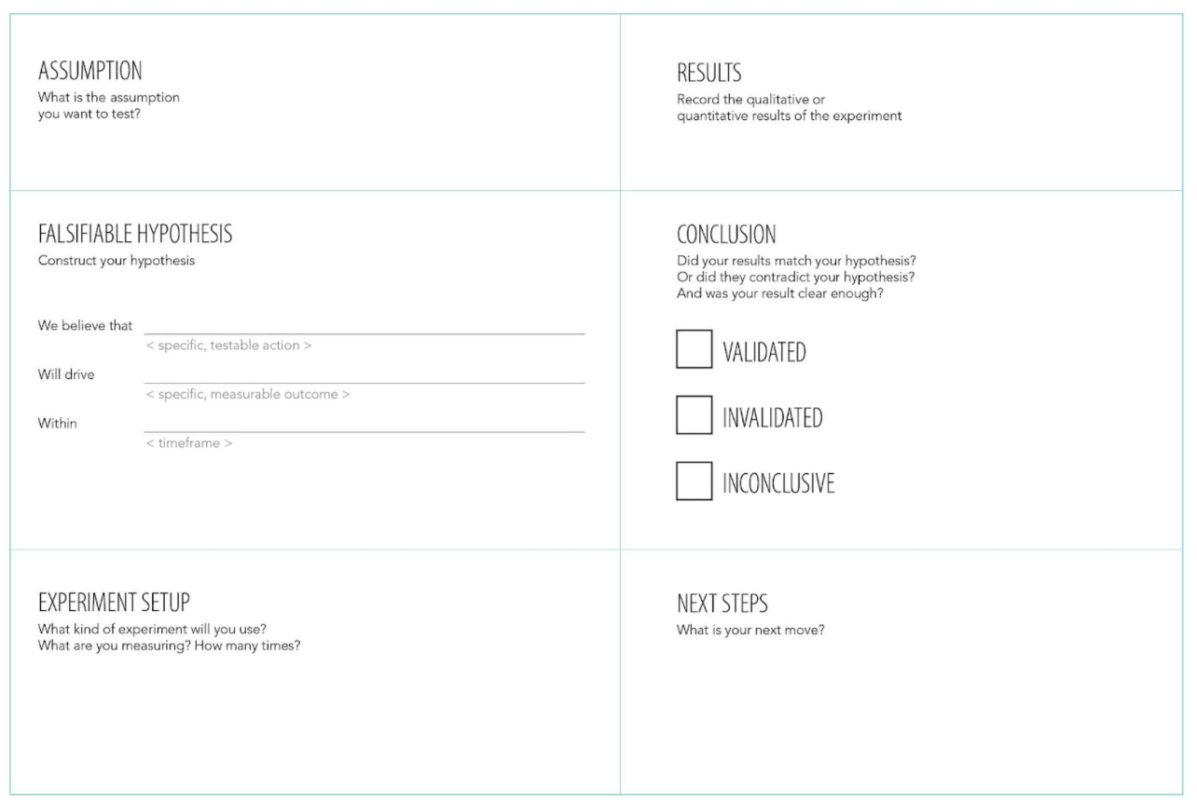


Slide 31

A good CMO
collaborates with CEO/
Management
on the basis of
experiments

Slide 32
Summary
Show up consistently with “good enough” content
Balance between short term and long term efforts
Be the maestro of your customer journey
Create and maintain a sales & marketing playbook
Track and communicate your plans as experiments

Slide 33

Thankyou!
Sign up for our new podcast
Sign up
Shoham@penguinstrategies.com

