Slide 1
HOW TO MAKE 2020
YOUR BEST YEAR EVER
Dan Tyre
HubSpot
December 2019
Notes:
https://www.microcorp.com/one-on-one/

Slide 3
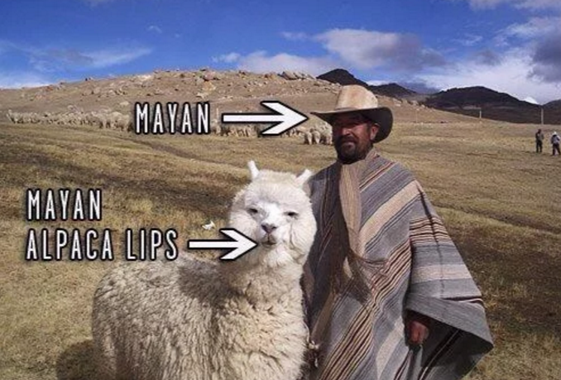

Slide 5
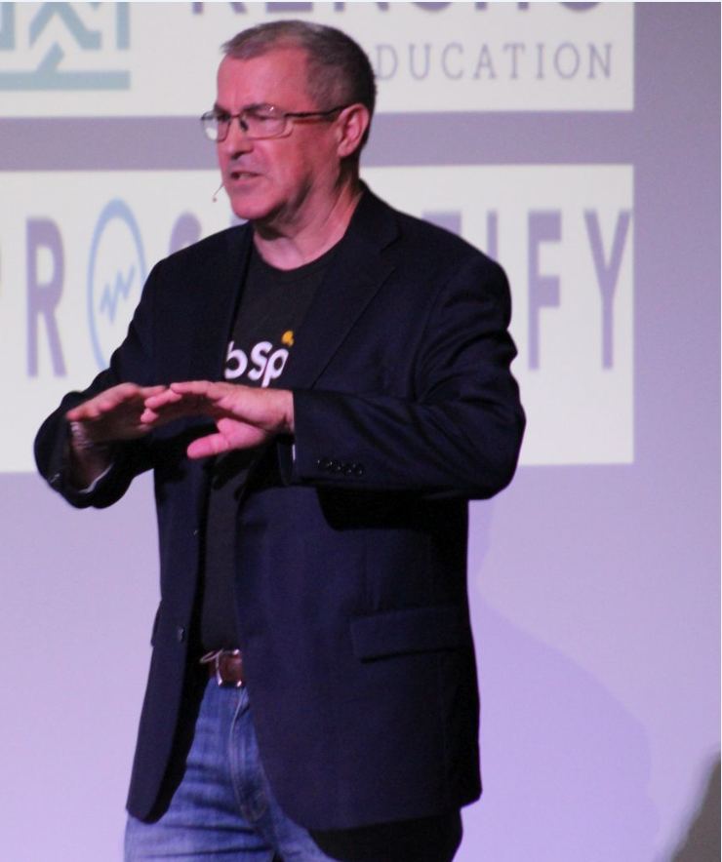
DAN
TYRE
www.linkedin.com/in/dantyre01/
Employee #6 at Hubspot
Five Start Ups Since 1983
Mentor, Advisor, Blogger, Speaker
Author, Angel Investor, Board Member
TRYING TO DO THE MOST GOOD FOR THE UNIVERSE

Slide 6
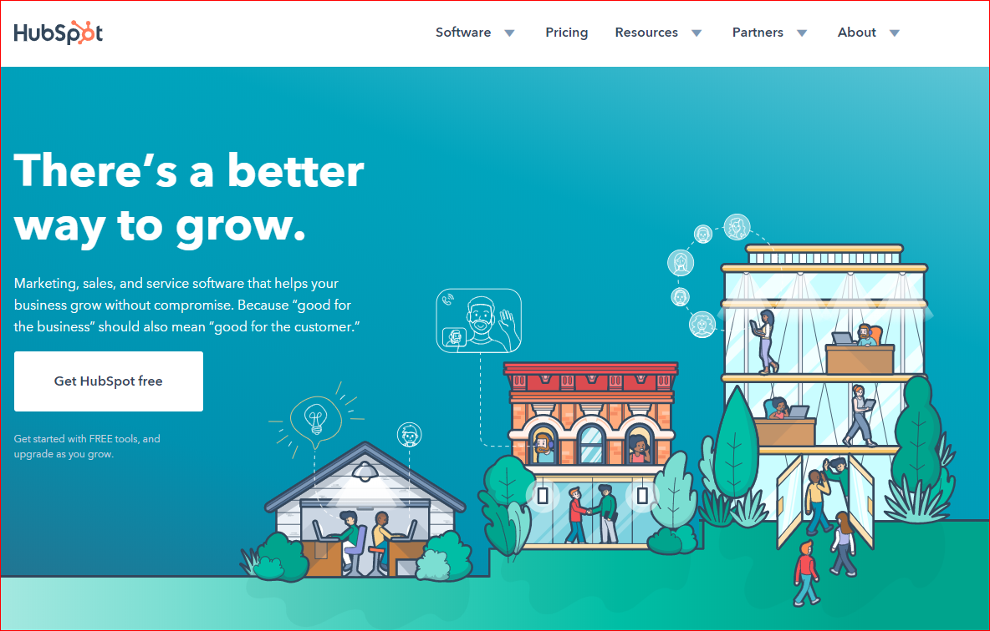
Notes:
https://www.hubspot.com/

Slide 7
What is
Inbound?

Slide 9
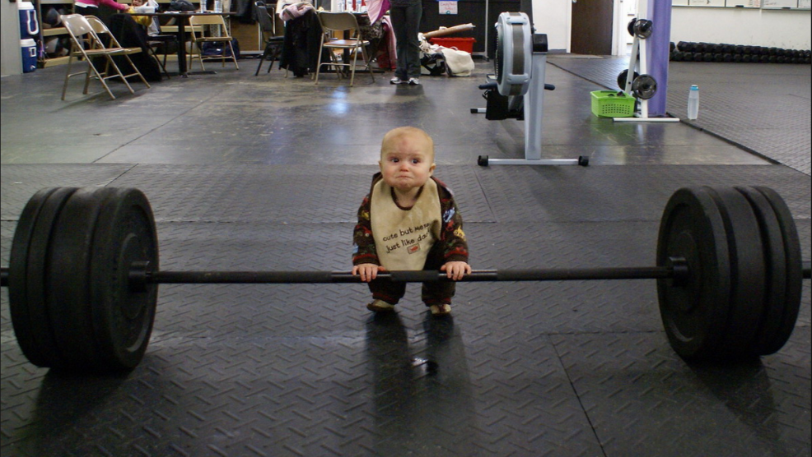

Slide 11
NOTE: Photo is only a guide, showing defeat or sighing
Notes:
(hang head and sigh loudly)
What I’m trying to say is that as a human race, our patience is at an all time low. Which means that our jobs as salespeople, as marketers, is harder than ever before because people are just hyper temperamental.
[istock #603274790]

Slide 12
NOTE: We’ll swap in a local beer for each city
Notes:
Today, you think of craft beer and you think of bars like Bangers on Rainy Street where the choices are endless. And it’s so hard to decide because they’re all good!
#updatebycity
https://www.stocksy.com/360858
For reference in other cities:
San Fran - Toronado
Austin - Bangers on Rainy Street

Slide 15
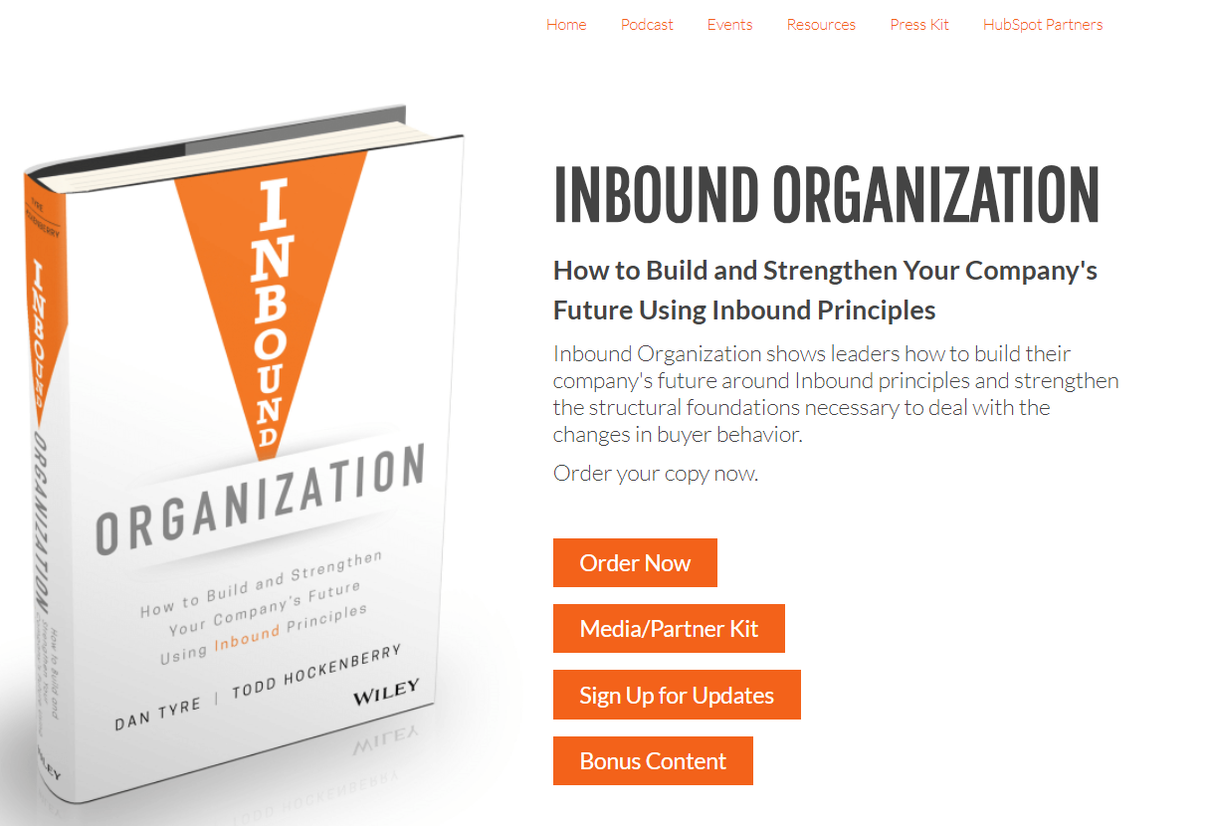
Notes:
https://www.inboundorganization.com/

Slide 16
https://www.inboundorganization.com/inbound-organization-assessment

Slide 17
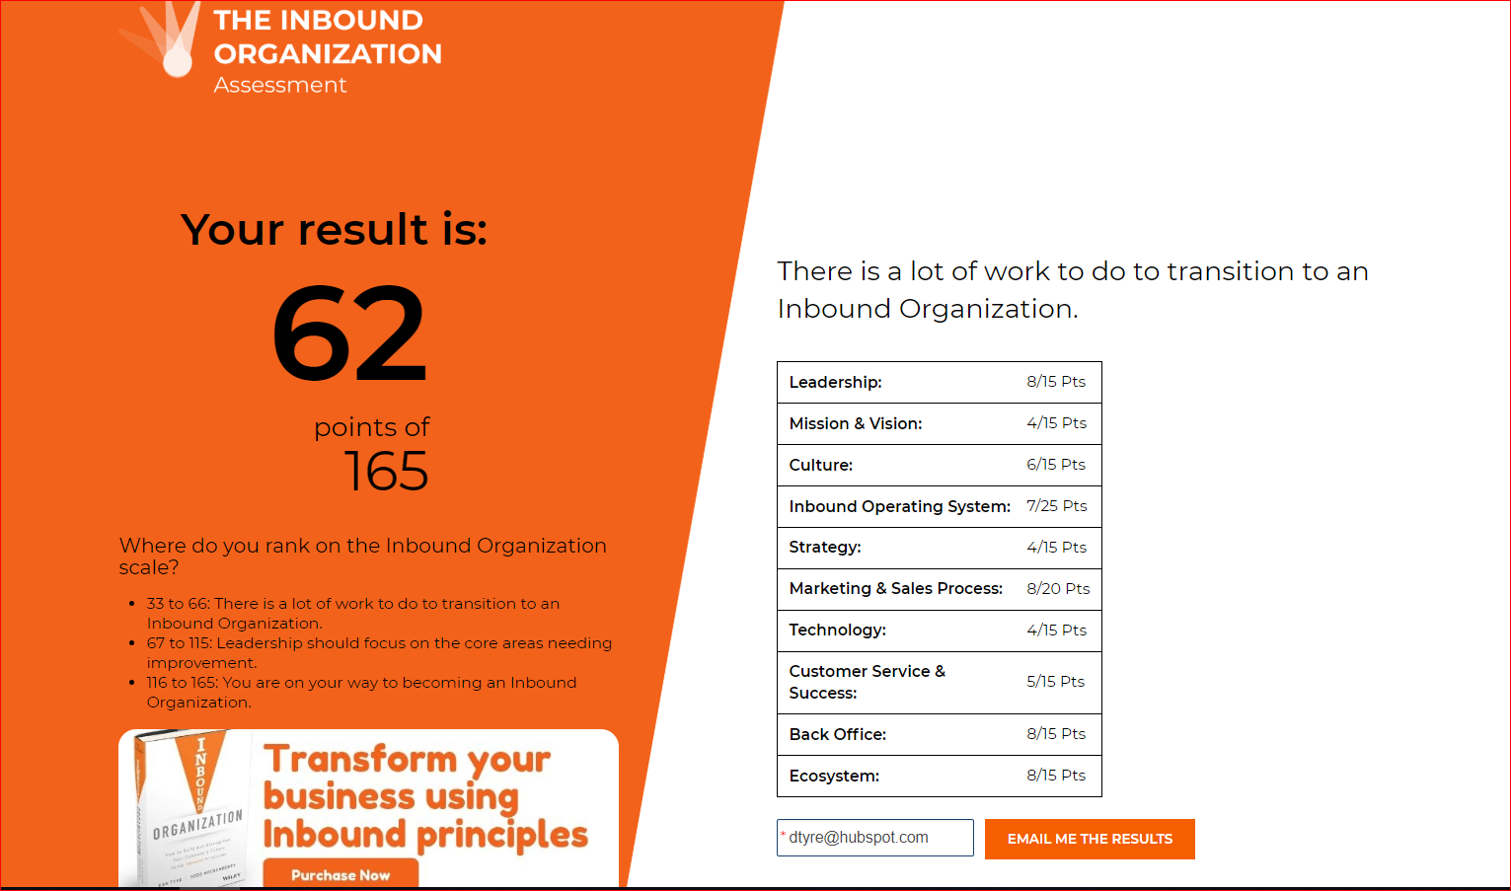

Slide 20
M-SPOT
MISSION:
STRATEGY/SERVE:
PLAYS: |  | TARGETS:
OMISSIONS:
Notes:
So this – is an MSPOT.
It stands for Mission , Strategy, Plays, Omissions, Targets
- Framework through which your whole company can outline your biggest goals, how, you’ll achieve and measure each.
- Start at the top of your company and work your way down.
- MSPOT for the company, and then supporting ones for your sales and marketing or services teams or product teams…
- This starts with your mission statement - large and aspirational.
- Your strategy details HOW you plan to get there
- From there – plays provide more specific guidance on what your company can pursue that are in line with your strategy – and that line up to your mission.
For each play – you want to have a target – or measurable goal
- Lastly – you’ll want to outline omissions. What will you NOT do this year. Omissions are often overlooked, but are one of the most important factors in building focus.
To make sure we’re all on the same page – lets walk though an example quickly

Slide 21
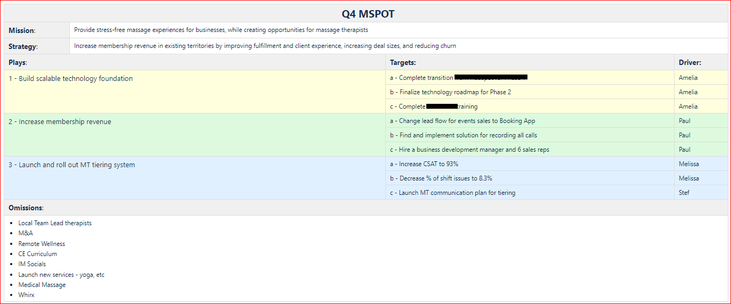

Slide 22
Customer Experience is the competitive advantage

Slide 23
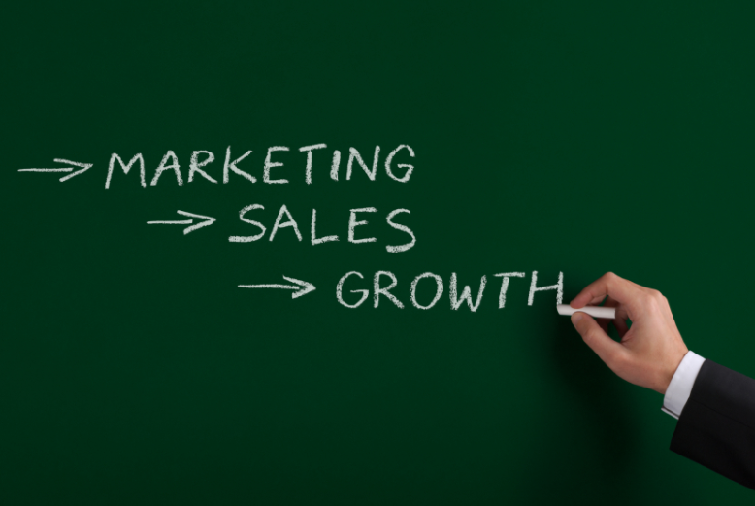

Slide 24
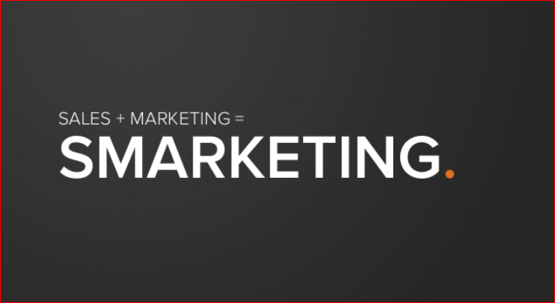

Slide 25
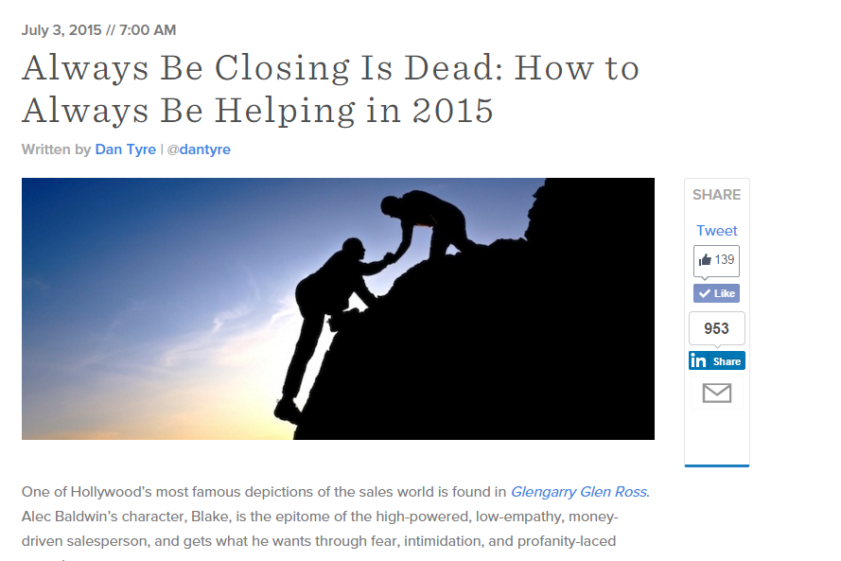

Slide 26
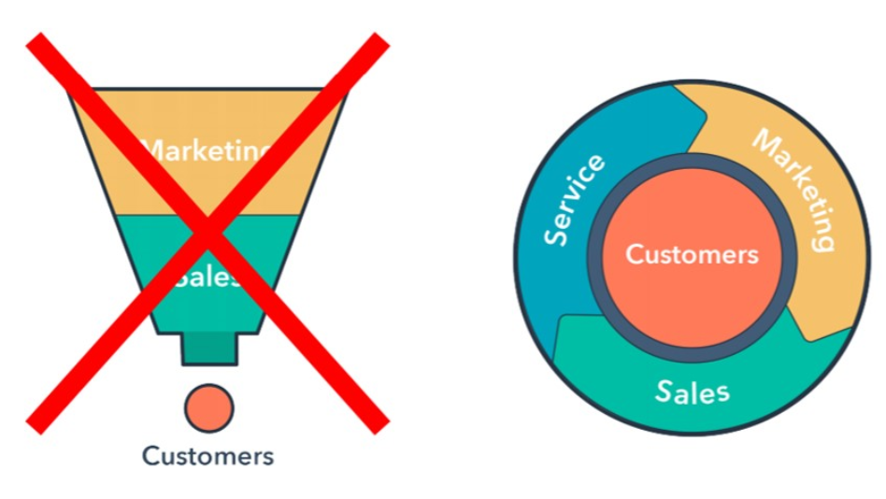

Slide 29
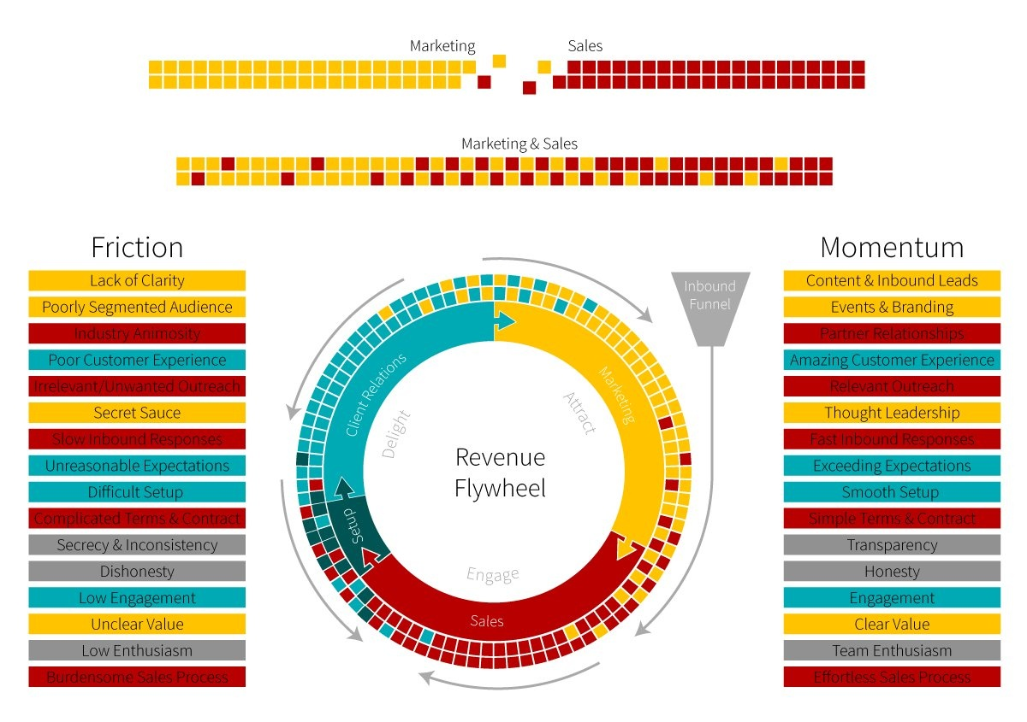
Sales-to-Service Friction
Wrong Buyer Persona
High Customer NPS
Unreasonable Expectations
Content and Inbound Leads
Poor Customer Experience
Easy Setup and Onboarding
Slow Response Time
Events and Branding
Complicated Terms and Contract
Fast Response Time
Complicated Sales Process
Effortless Sales Process
Notes:
Great example of a flywheel.
It still has a funnel! People like to see that we haven’t thrown out everything from the past.
The yellow/red squares at the top show two states: the top state is where all the Marketing people work only with other Marketing people, and only encounter a red/Salesperson at the coffee machine or the bathroom. The lower state shows Marketing and Sales people working in tandem, with fewer rough handoffs. The placement of the yellow/red/green/blue squares around the flywheel are used as suggestions here, not as headcount or specific roles/responsibilities.
Momentum -- forces applied to help improve overall customer experience -- is enumerated in the right hand column, according to function.
Friction is enumerated in the left hand column. Note some of them are the inverse of their corresponding Momentum on the right (“secret sauce” is a friction, while “thought leadership” is a force; “unreasonable expectations” is a friction incurred during client relations, while “exceeding expectations” is a force during client relations).
There are “negative momentum” arrows in the Setup and Client Relations phases.
The Setup phase for this SaaS product includes a relatively complex integration with existing systems (eCommerce on one end, in-house billing system on the other end). This particular company experienced a substantial churn during the Setup phase. During a pilot “flywheel” exercise, they began to include the Sales rep as part of the Setup stage, and reduced churn by 50%.
Doesn’t have specific metrics on it, which is something you’d want to have.
Marketing sit with marketing, sales sits with sales, and occassionaly they bump into each other on the way to the bathroom. This is what they want to have.
One thing I really like about this flywheel…it still has a funnel! People aren’t always thrilled about getting rid of the funnel – you still have the funnel, you’re still doing inbound, you’re still doing a lot of things right. The issue is, again, you’re treating a customer as an output.
We put the customer at the center. We move people around this funnel.
This customer also has a process called setup. They’re in the technology industry and help facilitate refunds/chargebacks with credit card companies and merchants. They have a fairly technical product. They found that marketing generates the leads, hands them to sales, and sales hands them over to services for setup, and they had a ton of issues – not the right people in the room, wrong documentation, misset expectiations, etc. They were losing 40% of their accounts due to poor setup! This is an obvious major issue. So: just like I mentioned we/HubSpot did with clawbacks or changed CSM goals, this company implemented a new rule: the sales person had to sit in on the setup process. The sales rep really is just there for handholding and not the actual setup – but through this process, they have cut their churn in half.
Obviously they had to make the decision to take that sales person off the selling floor – they’re not closing new deals, but its obvious this is a major issue for the company. Who owns this change? The company does, not any one team. The sales teams stopped setting the expectation that this was a super easyproduct to set up and changed their behavior to set real expectations – because they had to be part of the setup process. And then the sales people go back to the marketing people that maybe bullet number 1 isn’t “plug and play” – can we change this to be more realistic?
Almost every company has their “setup” problem.
Where are your forces aligned? Where are they misaligned? How can we solve it?
Sometimes its solved by technology, sometimes by organizational change.

Slide 31
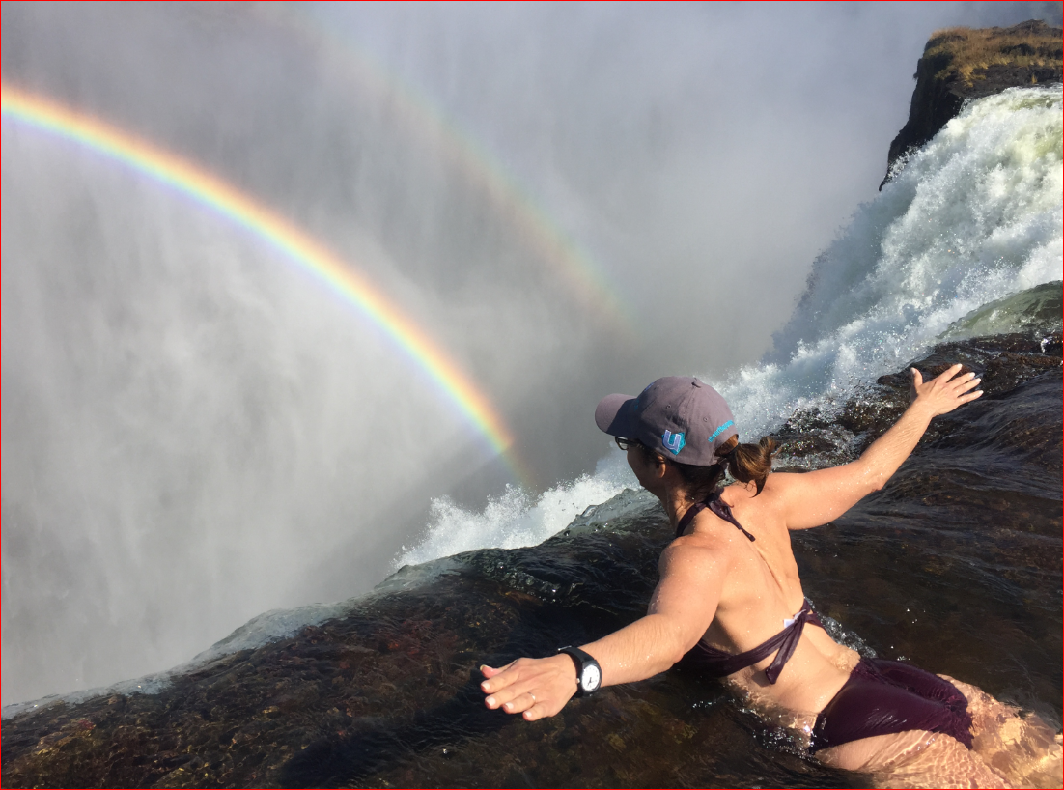

Slide 32
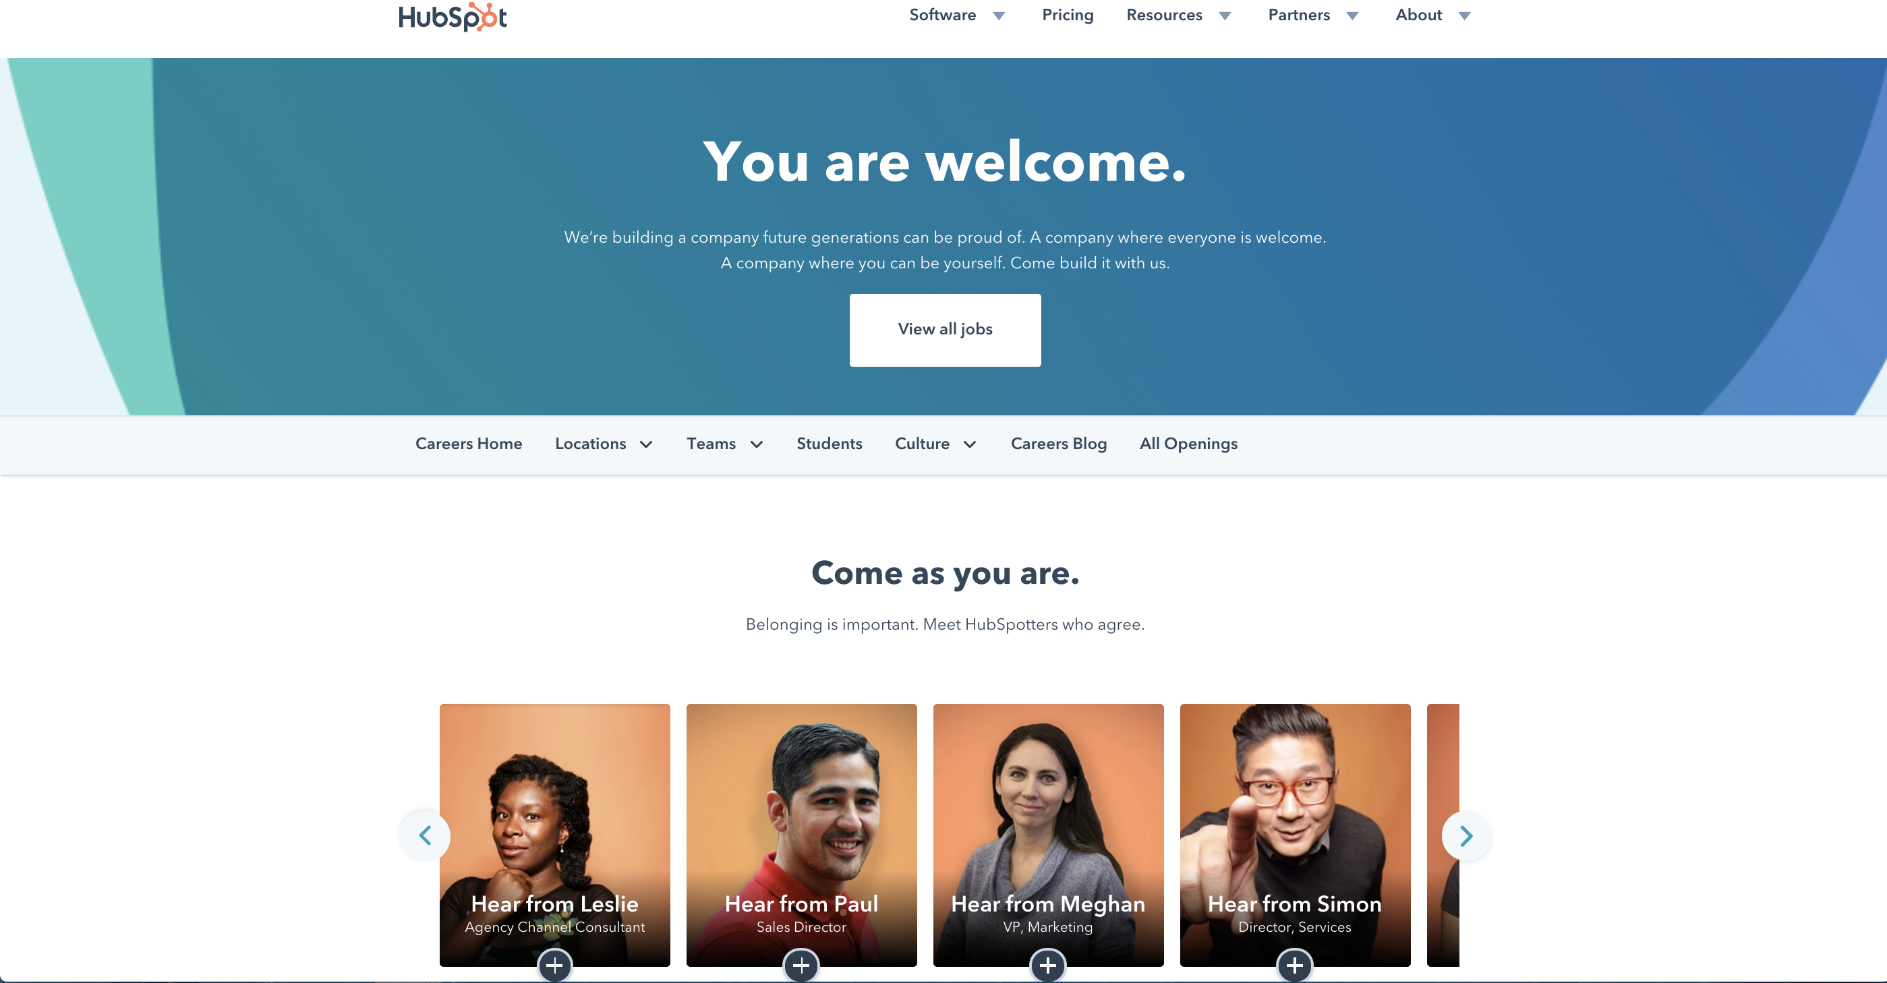
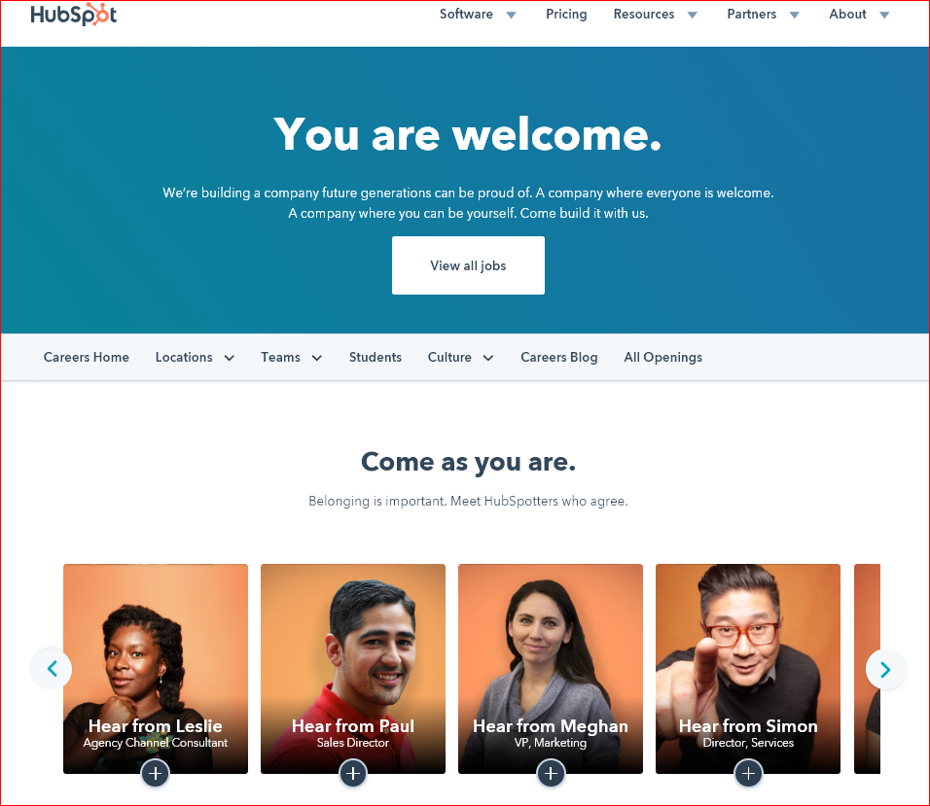
Notes:
https://www.hubspot.com/diversity-inclusion

Slide 34
Free Gifts

Slide 35
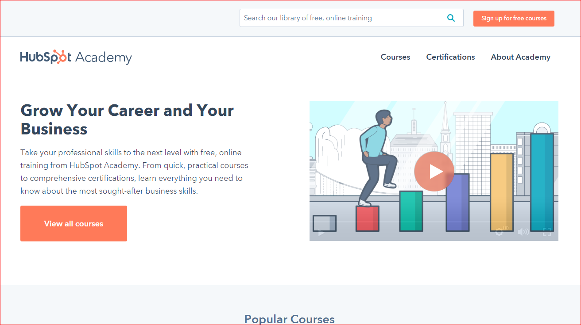
Notes:
https://academy.hubspot.com/

Slide 36
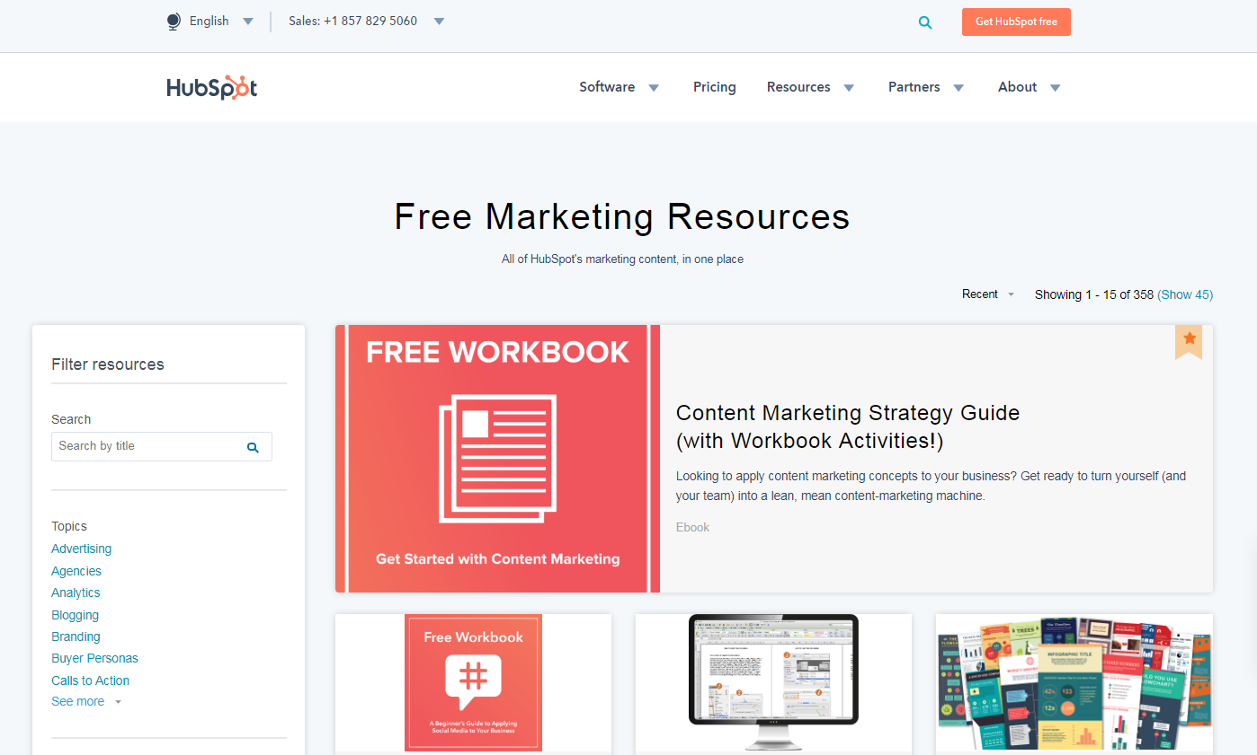

Slide 37
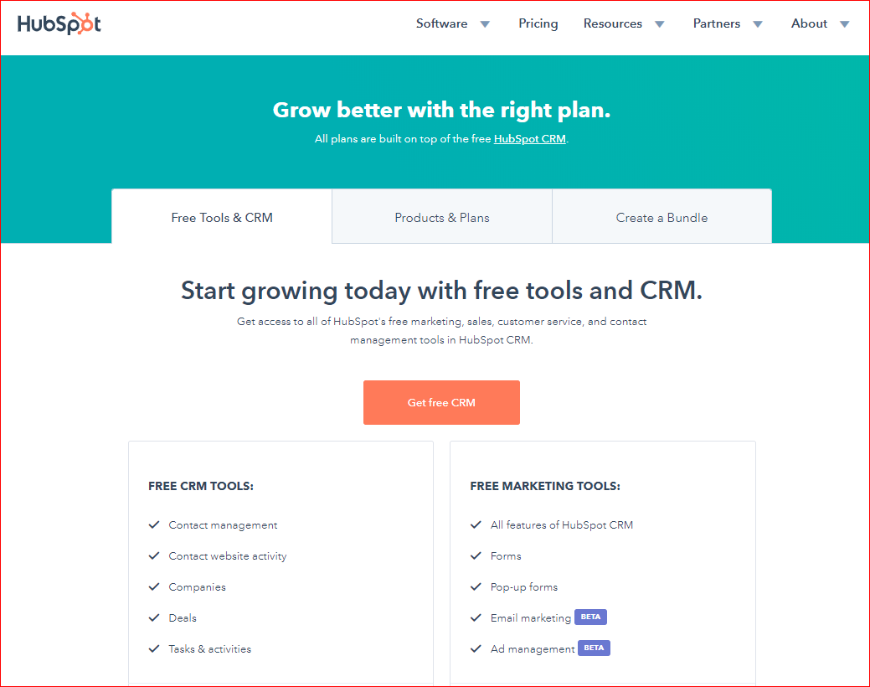
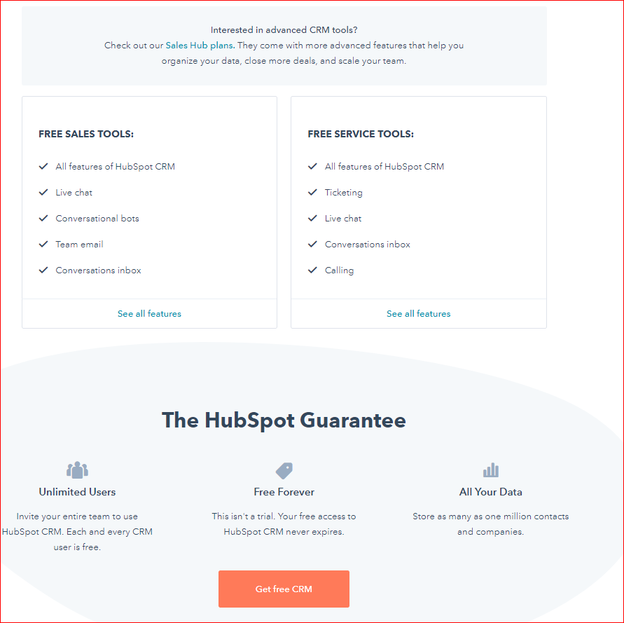

Slide 40
THANK YOU
(and a small ask)
Dan Tyre
dtyre@hubspot.com
www.inboundorganization.com
Notes:
Go, Go, Go

Slide 42
5 Steps to Marketing Alignment
Notes:
1. Understand the company, division & salesperson individual quota
2.
3.

