Slide 1
CMO Perspective:
Transformation Maker
Outwards to the market, inwards to the organization
Amit Daniel
SVP Marketing & Employer Brand

Slide 2
The Broadest Cyber Intelligence Portfolio
Serving the Leading Security Organizations
Intelligence Technology Pioneers
Global Leadership in Cyber Intelligence Solutions
Neutralize and Prevent Terror, Crime and Cyber Threats of Today and Tomorrow
Notes:
In the last 25 years Verint has become the global leader in the cyber intelligence market. We have helped hundreds of governments and security organizations all over the globe – from different security segments – including LEA, NS, NI, Military, Critical Infrastructure and other government agencies
We are pioneers in Intelligence technology. Together with our customers, we have developed the biggest cyber intelligence portfolio available in the market. We do this to help you prevent terror, crime and cyber threats. Today’s threats and also tomorrow’s.

Slide 3
CIS
$1.2B +
Traded in NASDAQ
6000+
400+
Security Agencies in 100 Countries
1000s
of Successful Intelligence Projects
Employees
1000+
Patents
$1B
Investment in R&D
over the last decade
16
Global Offices
7
Global R&D Centers
Notes:
Let me tell you a few quick facts about Verint:
We are traded on NASDAQ, with annual revenues of over $1.2B
We have more than 6000 employees
We consistently invest in R&D, with over a $1 B invested over the last 10 years
And a few words about Verint CIS:
We are a separated division specializing in cyber intelligence
We operate 7 R&D centers in worldwide locations
We serve more than 400 security agencies around the globe

Slide 4
THE WAY WE
Were
Our Market
Marketing = Sales
What is Marketing’s Value?

Slide 5
Transformation was a 4-year process
2015
2016
2017
2018
Regional MKT
Product Marketing
Digital
Demand Generation
Events
Sales Support
Positioning
Messaging
Value Prop
Attack-Plan
GTM
Website
Social
SEO
Marketing Automation
Paid Campaigns
Sales Development
Full Funnel Management
Trust
Value
Demand
Business Acceleration

Slide 6
Driving Transformation
Our first paid campaign

Slide 7
Market Opportunity
Market Opportunity
The Right Product
The Right Partner
Plan Big - Start Small
7

Slide 8
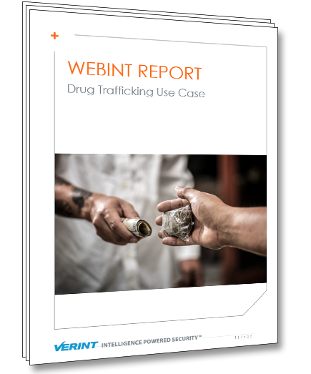
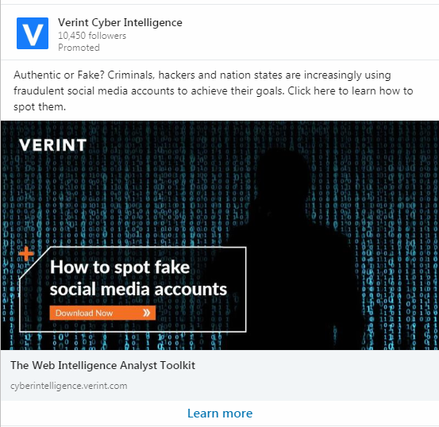
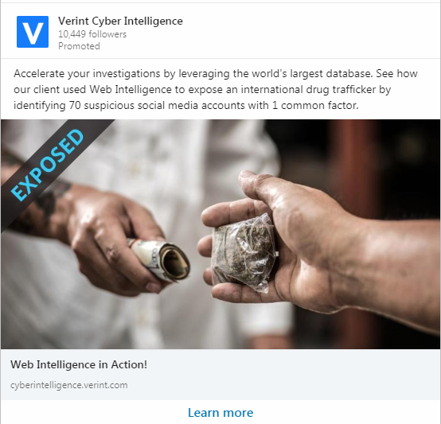
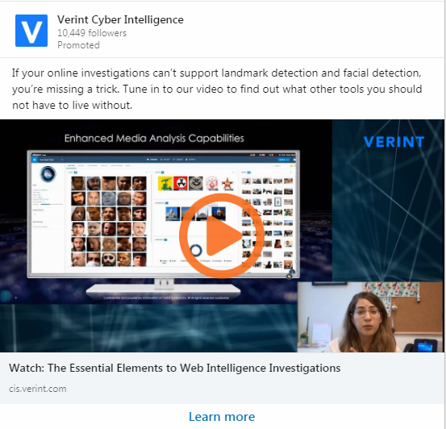
What we DID
Audience
Content
Promotion
Nurturing and Qualification
Digital Marketing
Product Marketing
Sales Development
Sales

Slide 9
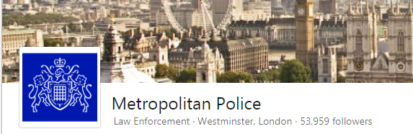
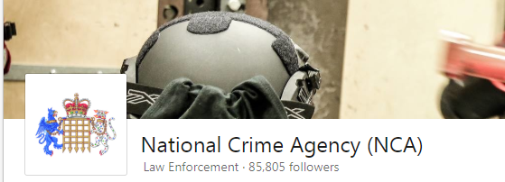
What we LEARNED?
Targeting
51,000+
From Top 40 UK
Law Enforcement Agencies

Slide 10
What we LEARNED?
Targeting
Content
Don’t sell, provide VALUE
Connect to current events
A/B Testing

Slide 11
What we LEARNED?
Targeting
Content
Own the journey
Acquisition
Engagement
Nurturing
Qualify
Sales Meeting

Slide 12
What we LEARNED?
Targeting
Content
Own the journey
Engage your partners
Product
Marketing
Demand
Generation
Sales
Development
Sales

Slide 13
What we LEARNED?
Targeting
Content
Own the journey
Engage your partners
Measure and Communicate
Measurable Awareness
Targeting+Content=Performance
7-10 avg. impressions / profile
CTR
0.8%
Conversion
4%
MQL
48.5%
Opps.
>10%

Slide 14
Driving Transformation
Employer Branding

Slide 15
MEET HR
15

Slide 16
MEET
Marketing
16

Slide 17
MEET
Employer Branding
17

Slide 18
Evaluation
Join
Consideration
Interest
Application
HR? Marketing?
18
Notes:
מי כאן ממארקטינג? מי כאן מ-HR? מי כאן מ-Employer Brand?
בואו ניקח דוגמה למשהו שכולכם מכירים. גיוס מועמד – ברור שזו משימה HRית, לא? אבל בואו נסתכל רגע על ה-funnel. יש פה חלקים שהם פר אקסלנס מארקטיאליים! כל הסיפור, השיווק, ההתייחסות למועמד כלקוח – זה הלחם והחמאה של השיווק. מנגד, כל תהליך המיון, הראיונות, הניבוי והניתוחים הפסיכולוגיים – זו המומחיות ה-HRית. אנחנו בשיווק רגילים לסייע לאנשי המכירות למכור את המוצר – ואין סיבה שלא נסייע ל-HR למכור את הארגון למועמדים ולעובדים הקיימים.

Slide 19
We dug deep - both Marketing and HR
Round tables
Personal interviews
All-units roadshow
Recruiting managers and recruiters interviews
Interviews with former employees
Notes:
ערכנו – גם אנחנו, גם HR, גם אקסטרה מייל – עבודה מחקר מאוד מעמיקה כדי לזקק את האיכויות שלנו

Slide 20
20

Slide 21
KPIs & Measurement – recruitment as an example
Awareness KPIs:
Performance KPIs:
Awareness KPIs:
Exposure to relevant audiences
Reach measurements
Engagement - likes, comments and shares
Number of relevant CVs received from the different channels
Increased CTR & conversion rate throughout the campaigns
21
Notes:
אז איך מודדים הצלחה של EB?

Slide 22
And how results
can look like…
373
87
287
78
61
57
42
22
13
CV
Not relevant
CV screen hiring manager
Withdraw+ Reject
In progress
Interviews
HR Interview
Salary offer
Hired
22

Slide 23
VERINT MARKETING
Regional Marketing
Demand Generation
Product Marketing
Sales Enablement
Employer Branding
Sales Development
Internal Marketing
Global Events

Slide 24
Thank You!
Amit.Daniel@Verint.com
Verint Cyber Intelligence

