Slide 1
ACCOUNT BASED
MARKETING
FOCUS YOUR EFFORTS

Slide 2


ACCOUNT-BASED MARKETING
ABM is a strategic approach that organizations are implementing to target and engage individual prospects within either new or exiting accounts.

Slide 3

LEAD GEN VS. ABM
AUDIENCE SELECTION
ACCOUNTS SELECTION
AWARENESS
CONTACTS ENRICHMENT
NURTURING
ACCOUNTS NURTURING
CONVERSION
CONVERSION
LEAD GENERATION
ABM

Slide 4




EFFICIENCY
Targeting the individuals/accounts
that have the most business potential
ROI
Generating pipeline and growing revenue within the right companies
PERSONALIZATION
Enables personalizing messaging and CTAs to specific accounts and persons
HOLISTIC APPROACH
Sales & marketing working together to drive engagement & generate revenue.
EFFICIENCY
ROI
PERSONALIZATION
HOLISTIC APPROACH

Slide 5
ABM GROWTH AMONG B2B COMPANIES
2019
72%
2018
58%
2017
36%
**Raising the Game with ABM: 2018 Benchmark Study | Research Report | SV4605R © 2018 ITSMA and ABM

Slide 6
29%
Of marketing
budget
**Raising the Game with ABM: 2018 Benchmark Study | Research Report | SV4605R © 2018 ITSMA and ABM

Slide 7
74.1%
Of companies who implemented an ABM strategy reported not having a programs that is well running

Slide 8










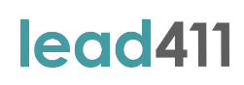


Slide 9





Slide 10


Slide 11


Slide 13
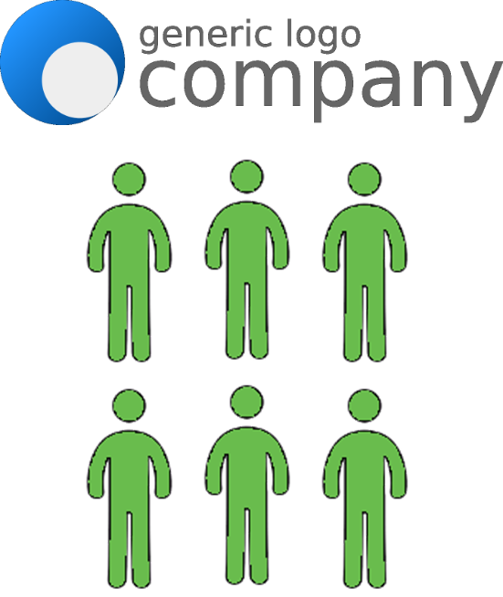

Slide 14
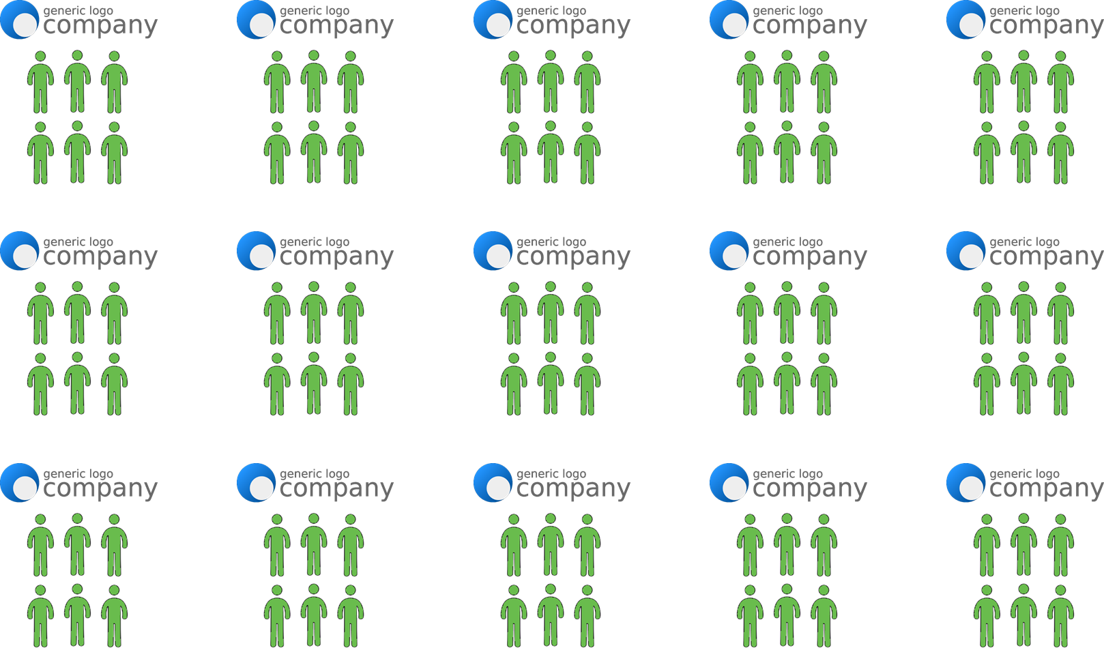

Slide 15
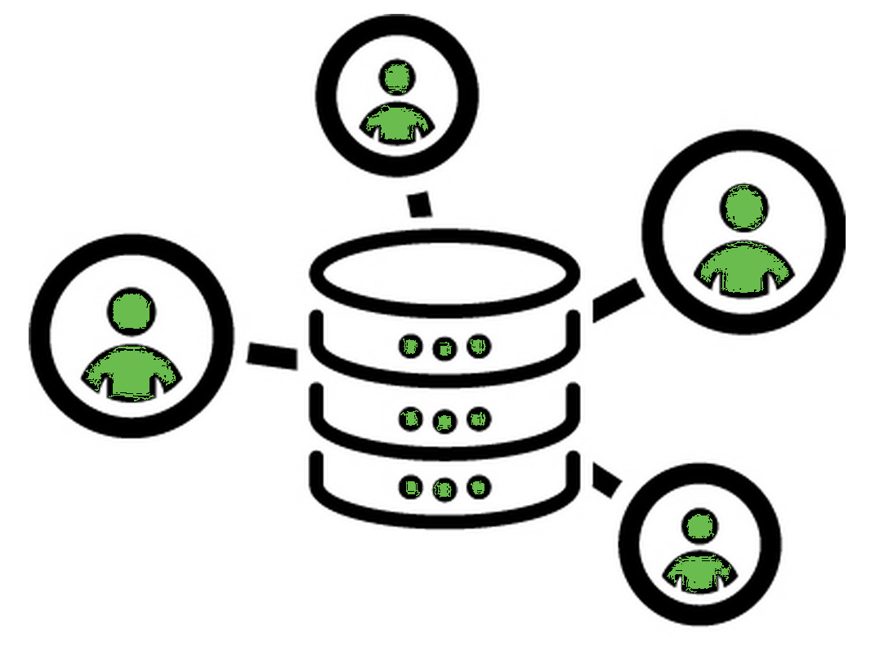
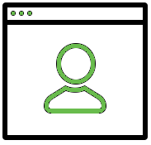


TOP 4
ABM
CHALLENGES
Personalizing and tailoring the marketing to the key contacts at each account
Getting adequate budget to support programs and resources
PERSONALIZATION
RESOURCES
Enrich data and knowledge about each account and business persona
Developing campaign assets that are mass customizable to allow scale
DATA
CONTENT
**Raising the Game with ABM: 2018 Benchmark Study | Research Report | SV4605R © 2018 ITSMA and ABM

Slide 16
LEAD GEN VS. ABM
AUDIENCE SELECTION
ACCOUNTS SELECTION
AWARENESS
CONTACTS ENRICHMENT
NURTURING
ACCOUNTS NURTURING
CONVERSION
CONVERSION
LEAD GENERATION
ABM

Slide 17
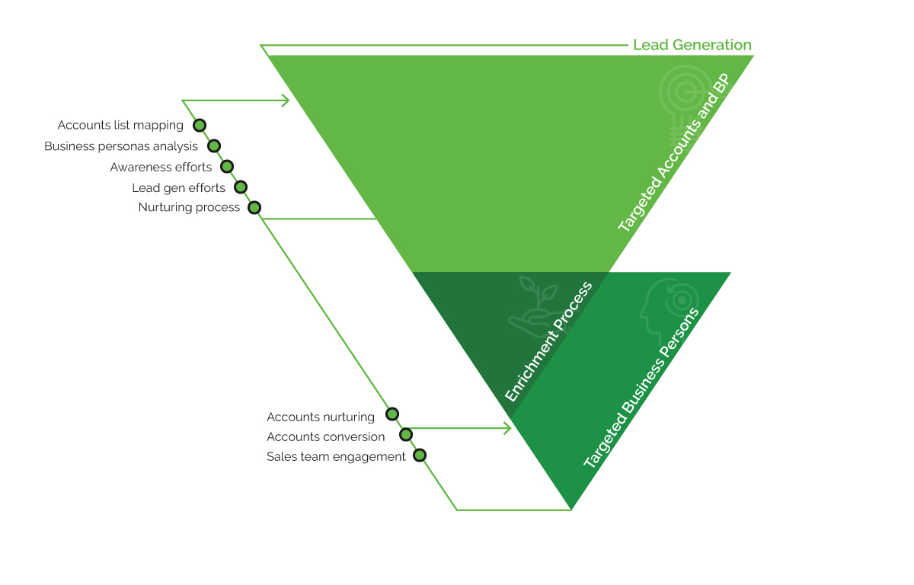

Slide 18
ACCOUNTS MAPPING
Similar Accounts
3
Wish List
2
Existing Data Base
1

Slide 19
ACCOUNTS MAPPING
Similar Accounts
3
Wish List
2
Existing Data Base
Prospects
Lost deals
Past customers
1

Slide 20
ACCOUNTS MAPPING
Similar Accounts
3
Tier 2
Tier 3
Wish List
2
Existing Data Base
Tier 1
1

Slide 21
ACCOUNTS MAPPING
Needs
Technology
Revenue
GEO
Similar Accounts
3
Wish List
2
Existing Data Base
1

Slide 22
LEAD GEN CAMPAIGN MATEIX
Business persona
Stakeholders
Decision makers
Message #1
Message #2
Message #3
BUSINESS PERSONA
MESSAGING
Prospects
Wish list
Similar accounts
Awareness
Consideration
Decision
ACCOUNTS TYPE
STAGE

Slide 23


LEAD GEN CAMPAIGN MATEIX

Slide 24
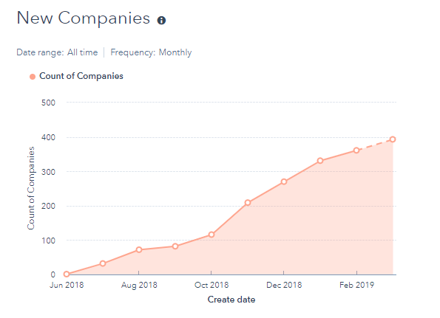
ENGAGEMENT ANALYSIS

Slide 25
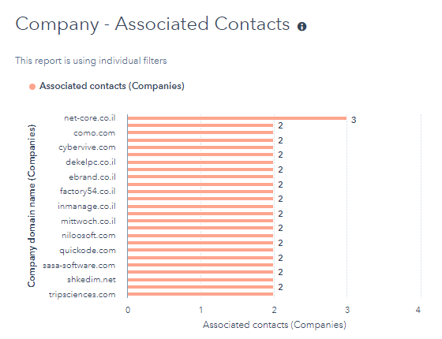
ENGAGEMENT ANALYSIS

Slide 26
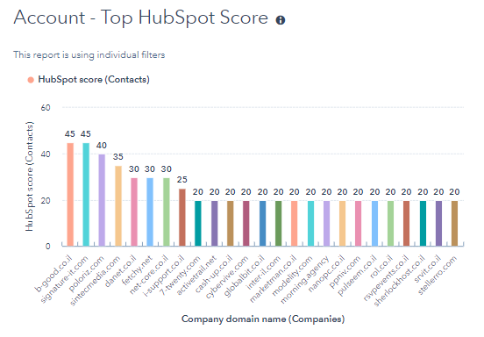
ENGAGEMENT ANALYSIS

Slide 27
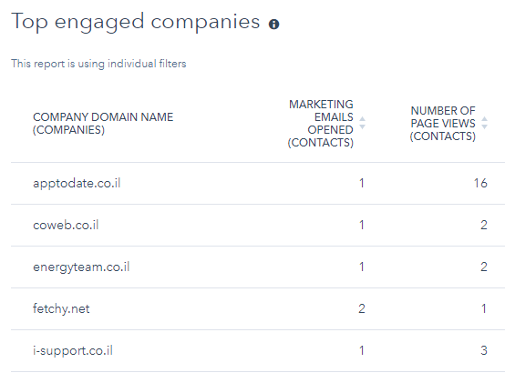
ENGAGEMENT ANALYSIS

Slide 28
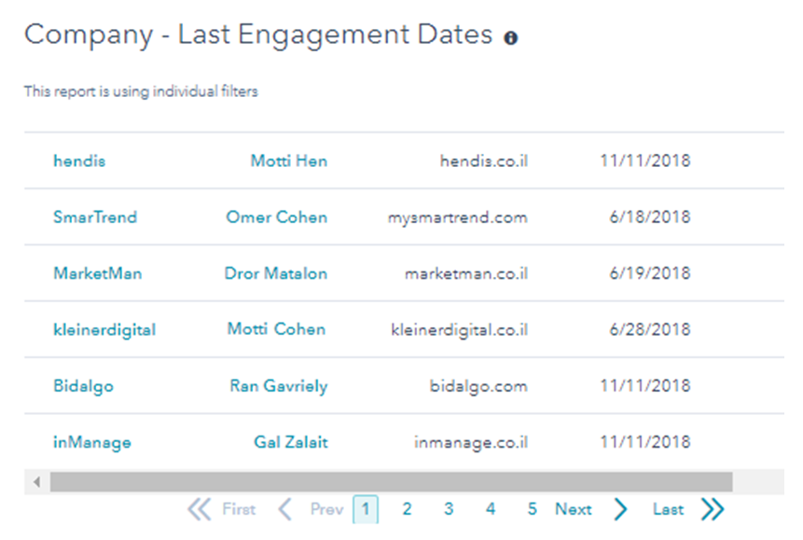
ENGAGEMENT ANALYSIS

Slide 29
ENRICHMENT ANALYSIS
Marketing filtering
Sales team Segmentation
Tier 1 accounts
Tier 2 accounts
Tier 3 accounts
Non relevant
Deep enrichment research
Deep enrichment research
General nurturing
Out of funnel
Sales team process
Customized content

Slide 32
TIER 1
TIER 2
TIER 3
NOT RELEVANT

Slide 33
TIER 1
TIER 2
TIER 3
NOT RELEVANT
DEEP ENRICHMENT

Slide 34
TIER 1
TIER 2
Vs.

Slide 35
DEEP ENRICHMENT
Info | Tier 1 | Tier 2 | Tier 3
Personal email | Yes | Yes | Yes
Work email | Yes | Yes | Yes
Professional skills | Yes | Yes | No
Professional interests | Yes | Yes | No
Groups on social media | Yes | Yes | No
Social media links (LinkedIn, Facebook, twitter) | Yes | Yes | No
Personal Overview | Yes | No | No
Education | Yes | No | No
Previous positions | Yes | No | No
Personal information: age, hometown, marital status | Yes | No | No
Personal interests | Yes | No | No
Related articles, Posts, Interviews. PR | Yes | No | No
Conferences he participated in the past | Yes | No | No

Slide 36

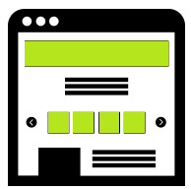


ACCOUNTS NURTURING
Personalized emails
Customized landing pages
Dedicated Whitepapers
LinkedIn personal messages

Slide 37
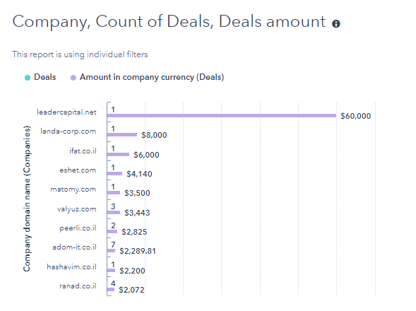
SALES & MARKETING ALIGNMENT

Slide 38
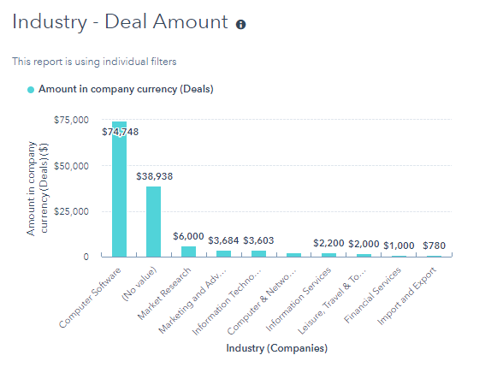
SALES & MARKETING ALIGNMENT

Slide 39
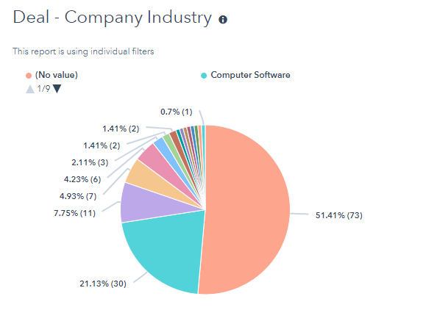
SALES & MARKETING ALIGNMENT

Slide 40
Personalizing and tailoring the marketing to the key contacts at each account
Narrow down your investment of time and budget
Easier to customize content based on previous interests
Getting adequate budget to support programs and resources
PERSONALIZATION
RESOURCES
More robust way to increase your accounts’ data base
Focus your efforts-
create content only to high engaged personas and accounts
Enrich data and knowledge about each account and business persona
Developing campaign assets that are mass customizable to allow scale
DATA
CONTENT

Slide 41
ACCOUNT BASED
MARKETING
THANK YOU

